Slide 1
RISK ASSESSMENT AND DATA ENTRY TOOLKIT FOR MANUAL SCAVENGERS

Slide 2
Problem statement
Deaths of manual scavengers happening inside sewers and septic tanks due to asphyxia.
Injustice happening even after deaths due to data manipulation /lack of enough data.

Slide 3
TN stands second in sewer based deaths.
6 people die every month!
And a lot more just go unreported...

Slide 4


USER JOURNEY

Slide 5
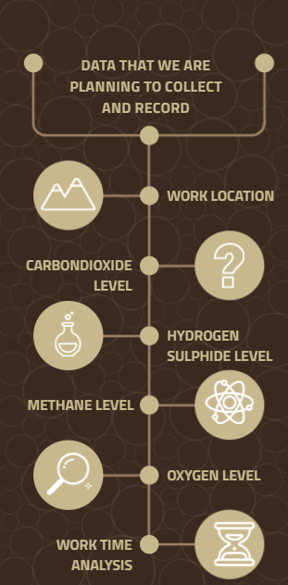

Slide 6
1
2
3
4
5
Interviews
Users
NGO
Research students
Prototype
Basic app
for usability check
Design
Sensor system
(and)
App
Sales
Individual customer
NGO’s
Govt sector
Expansion
Semi Machinery options

Slide 7
SALES AND REVENUE
GOVT CONTRACTS
NGO ALLIES
USERS

Slide 8
FUTURE EXPANSION
Filling the gap between brooms and robots!

Slide 9
“People oppress people. Science doesn’t!”

Slide 10
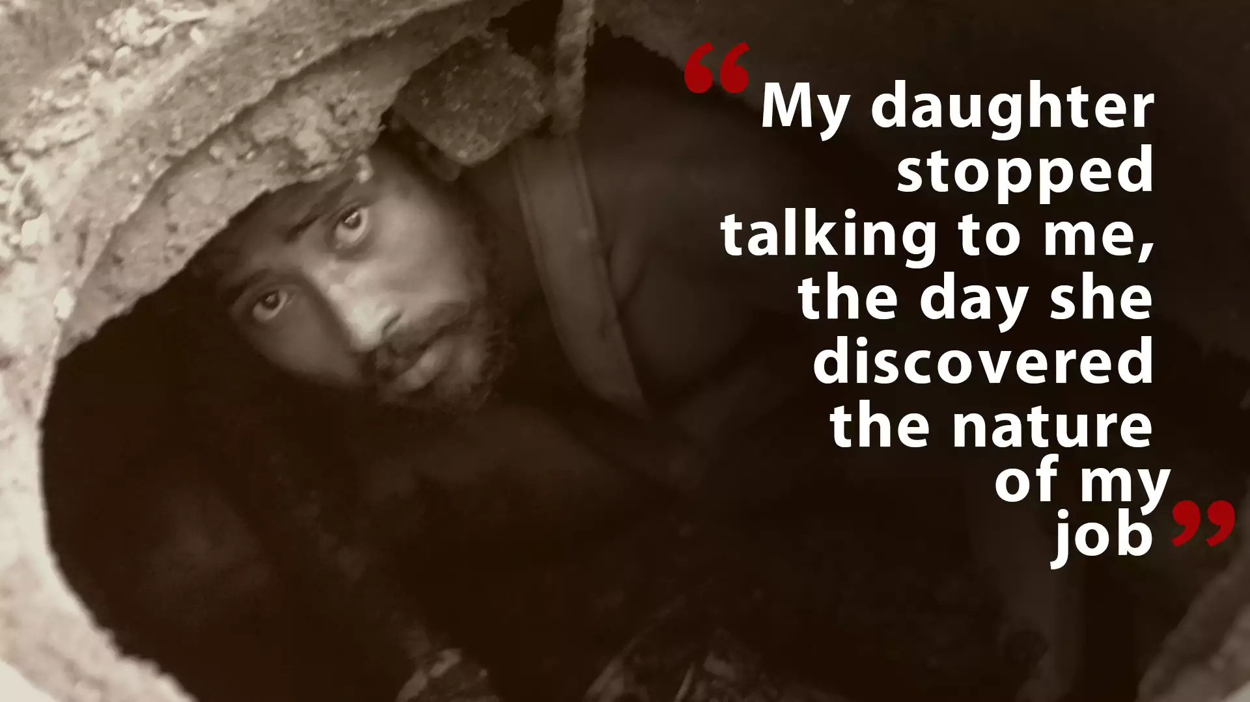
ANY QUESTIONS?

